Slide 1
Committee on Teaching About the United Nations January 24, 2021
Presentation by:
Dr. Wilton Littlechild, IPC International Chief

Slide 2
OUTLINE
Background: The early days….
Lands, Territories and Resources
Political and Economic Rights
Articles on Education
Steps to Implementation
Nationhood

Slide 3
UN Declaration on the Rights of Indigenous Peoples
The Eagle representing First Nations –
one wing represents the Treaties and the other wing
represents the UN Declaration. It takes both wings to lift-up and
give our rights as First Nations the ability to soar.

Slide 4
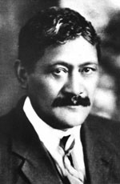
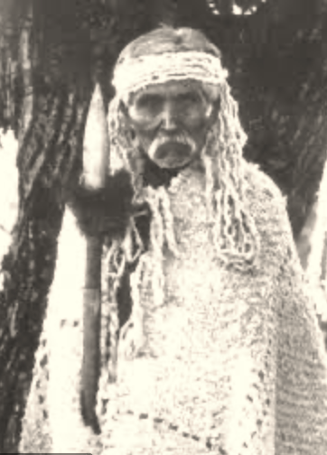
Chief Deskaheh Ratana
Haudenosaunee (Cayuga) Maori Spiritual Leader
Denied access to the League of Nations in 1923 & 1925
Chief David Latasse
Douglas Treaty
Chiefs of BC also approached the League of Nations
4
Notes:
Two attempts were made to take Indigenous matters to the League of Nations.
Chief Deskaheh in 1923
Ratana in 1925
4

Slide 5
Universal Declaration on Human Rights
1948
John Peters Humphrey

Slide 6
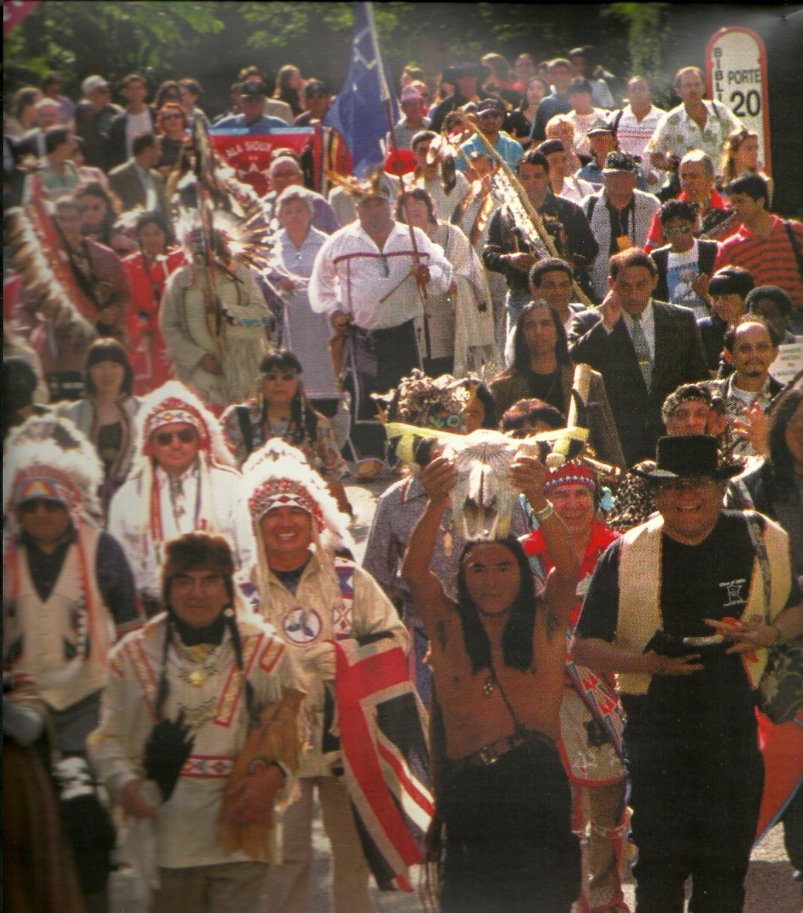
Background The United Nations Declaration on the Rights of Indigenous Peoples (the UN Declaration) was adopted by the UN General Assembly on September 13, 2007. Indigenous peoples from around the world worked for decades to achieve this success. Chiefs have passed numerous resolutions supporting the Declaration.

Slide 7
Considering that the rights affirmed in treaties, agreements and other constructive arrangements between States and indigenous peoples are, in some situations, matters of international concern, interest, responsibility and character Treaty right to Education (Little red school house)

Slide 8
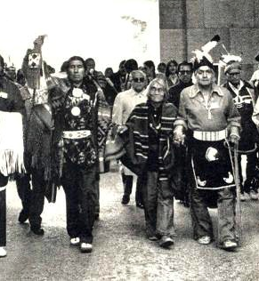
Significance of UN Declaration
UN Declaration, 7th preambular para.
Recognizing the urgent need to respect and promote the inherent rights of indigenous peoples which derive from their political, economic and social structures and from their cultures, spiritual traditions, histories and philosophies, especially their rights to their lands, territories and resources …

Slide 9
Foundational Rights
Article 3 (Self-Determination)
Indigenous peoples have the right to self-determination. By virtue of that right they freely determine their political status and freely pursue their economic, social and cultural development.
Article 4 (A Component of Self-Determination)
Indigenous peoples, in exercising their right to self-determination, have the right to autonomy or self-government in matters relating to their internal and local affairs, as well as ways and means for financing their autonomous functions.

Slide 10
LANDS, TERRITORIES AND RESOURCES
Article 25 (A Distinctive Relationship)
Indigenous peoples have the right to maintain and strengthen their distinctive spiritual relationship with their traditionally owned or otherwise occupied and used lands, territories, waters and coastal seas and other resources and to uphold their responsibilities to future generations in this regard.
Article 26 (Use and Ownership)
Indigenous peoples have the right to the lands, territories and resources which they have traditionally owned, occupied or other- wise used or acquired.
Indigenous peoples have the right to own, use, develop and control the lands, territories and resources that they possess by rea- son of traditional ownership or other traditional occupation or use, as well as those which they have otherwise acquired.
States shall give legal recognition and protection to these lands, territories and resources. Such recognition shall be conducted with due respect to the customs, traditions and land tenure systems of the indigenous peoples concerned.

Slide 11
Article 27 (Adjudication)
States shall establish and implement, in conjunction with indigenous peoples concerned, a fair, independent, impartial, open and transparent process, giving due recognition to indigenous peoples’ laws, traditions, customs and land tenure systems, to recognize and adjudicate the rights of indigenous peoples pertaining to their lands, territories and resources, including those which were traditionally owned or otherwise occupied or used. Indigenous peoples shall have the right to participate in this process.

Slide 12
Article 28 (Redress)
Indigenous peoples have the right to redress, by means that can include restitution or, when this is not possible, just, fair and equitable compensation, for the lands, territories and resources which they have traditionally owned or otherwise occupied or used, and which have been confiscated, taken, occupied, used or damaged without their free, prior and informed consent.
Unless otherwise freely agreed upon by the peoples concerned, compensation shall take the form of lands, territories and resources equal in quality, size and legal status or of monetary compensation or other appropriate redress.

Slide 13
Dispute Mechanism
Article 40 (Dispute Settlement)
Indigenous peoples have the right to access to and prompt decision through just and fair procedures for the resolution of conflicts and disputes with States or other parties, as well as to effective remedies for all infringements of their individual and collective rights. Such a decision shall give due consideration to the customs, traditions, rules and legal systems of the indigenous peoples concerned and international human rights

Slide 14
Article 29 (Environmental Protection)
Indigenous peoples have the right to the conservation and protection of the environment and the productive capacity of their lands or territories and resources. States shall establish and implement assistance programmes for indigenous peoples for such conservation and protection, without discrimination.
States shall take effective measures to ensure that no storage or disposal of hazardous materials shall take place in the lands or territories of indigenous peoples without their free, prior and informed consent.
States shall also take effective measures to ensure, as needed, that programmes for monitoring, maintaining and restoring the health of indigenous peoples, as developed and implemented by the peoples affected by such materials, are duly implemented.

Slide 15
Article 31 (Cultural Heritage)
Indigenous peoples have the right to maintain, control, protect and develop their cultural heritage, traditional knowledge and tra- ditional cultural expressions, as well as the manifestations of their sciences, technologies and cultures, including human and genetic resources, seeds, medicines, knowledge of the properties of fauna and flora, oral traditions, literatures, designs, sports and traditional games and visual and performing arts. They also have the right to maintain, control, protect and develop their intellectual property over such cultural heritage, traditional knowledge, and traditional cultural expressions.
In conjunction with indigenous peoples, States shall take effective measures to recognize and protect the exercise of these rights.

Slide 16
NATIONHOOD
UN Declaration Preambular Paragraphs…
Considering that the rights affirmed in treaties, agreements and other constructive arrangements between States and indigenous peoples are, in some situations, matters of international concern, interest, responsibility and character
Considering also that treaties, agreements and other constructive arrangements, and the relationship they represent, are the basis for a strengthened partnership between indigenous peoples and States

Slide 17
Article 37 (Treaties and Agreements)
Indigenous peoples have the right to the recognition, observ- ance and enforcement of treaties, agreements and other constructive arrangements concluded with States or their successors and to have States honour and respect such treaties, agreements and other constructive arrangements.
Nothing in this Declaration may be interpreted as diminishing or eliminating the rights of indigenous peoples contained in treaties, agreements and other constructive arrangements.

Slide 18
Political and Economic Rights
Article 18 (Decision-Making)
Indigenous peoples have the right to participate in decision-making in matters which would affect their rights, through representatives chosen by themselves in accordance with their own procedures, as well as to maintain and develop their own indigenous decision- making institutions.
Article 19 (Political Partnership)
States shall consult and cooperate in good faith with the indigenous peoples concerned through their own representative institutions in order to obtain their free, prior and informed consent before adopting and implementing legislative or administrative measures that may affect them.

Slide 19
Article 21 (Special Measures)
Indigenous peoples have the right, without discrimination, to the improvement of their economic and social conditions, including, inter alia, in the areas of education, employment, vocational training and retraining, housing, sanitation, health and social security.
States shall take effective measures and, where appropriate, spe- cial measures to ensure continuing improvement of their economic and social conditions. Particular attention shall be paid to the rights and special needs of indigenous elders, women, youth, children and persons with disabilities.

Slide 20
Article 22 (Recognition of Special Needs)
Particular attention shall be paid to the rights and special needs of indigenous elders, women, youth, children and persons with dis- abilities in the implementation of this Declaration.
States shall take measures, in conjunction with indigenous peoples, to ensure that indigenous women and children enjoy the full protection and guarantees against all forms of violence and discrimination.
Article 23 (Self-Development)
Indigenous peoples have the right to determine and develop priorities and strategies for exercising their right to development. In particular, indigenous peoples have the right to be actively involved in developing and determining health, housing and other economic and social programmes affecting them and, as far as possible, to administer such programmes through their own institutions.

Slide 21
Article 32 (Free, Prior and Informed Consent)
Indigenous peoples have the right to determine and develop priorities and strategies for the development or use of their lands or territories and other resources.
States shall consult and cooperate in good faith with the indigenous peoples concerned through their own representative institutions in order to obtain their free and informed consent prior to the approval of any project affecting their lands or territories and other resources, particularly in connection with the development, utilization or exploitation of mineral, water or other resources.
States shall provide effective mechanisms for just and fair redress for any such activities, and appropriate measures shall be taken to mitigate adverse environmental, economic, social, cultural or spiritual impact.

Slide 22
Articles on education
Article 12 (Spiritual and Religious Traditions)
Indigenous peoples have the right to manifest, practise, develop and teach their spiritual and religious traditions, customs and ceremonies; the right to maintain, protect, and have access in privacy to their religious and cultural sites; the right to the use and control of their ceremonial objects; and the right to the repatriation of their human remains.
States shall seek to enable the access and/or repatriation of ceremonial objects and human remains in their possession through fair, transparent and effective mechanisms developed in conjunction with indigenous peoples concerned.

Slide 23
Articles on education
Article 13 (Language)
Indigenous peoples have the right to revitalize, use, develop and transmit to future generations their histories, languages, oral traditions, philosophies, writing systems and literatures, and to designate and retain their own names for communities, places and persons.
States shall take effective measures to ensure that this right is protected and also to ensure that indigenous peoples can understand and be understood in political, legal and administrative proceedings, where necessary through the provision of interpretation or by other appropriate means.

Slide 24
Articles on education
Article 14 (Education)
Indigenous peoples have the right to establish and control their educational systems and institutions providing education in their own languages, in a manner appropriate to their cultural methods of teaching and learning.
Indigenous individuals, particularly children, have the right to all levels and forms of education of the State without discrimination.
States shall, in conjunction with indigenous peoples, take effective measures, in order for indigenous individuals, particularly children, including those living outside their communities, to have access, when possible, to an education in their own culture and provided in their own language.

Slide 25
Articles on education
Article 15 (Knowledge)
Indigenous peoples have the right to the dignity and diversity of their cultures, traditions, histories and aspirations which shall be appropriately reflected in education and public information.
States shall take effective measures, in consultation and cooperation with the indigenous peoples concerned, to combat prejudice and eliminate discrimination and to promote tolerance, understanding and good relations among indigenous peoples and all other segments of society.

Slide 26
Steps to Implementation: 2007
Governance – adoption & implementation of the UN Declaration by Indigenous Peoples, Nations and Tribes;
Inclusion of the UN Declaration in the Constitutions of Indigenous Peoples, Nations and Tribes;
Work on having the domestic regional, state or provincial/municipal governments support and endorse the UN Declaration;
State – Federal, provincial/territorial levels – ensure that new legislation is introduced and adopted now on the implementation of the UN Declaration
Utilize all relevant Parliamentary and Legislature Committees
Academic level – include UN Declaration in the curriculum, all schools and colleges should be teaching the UN Declaration
Local level – Educate Re: UN Declaration, within Indigenous Peoples, Nations and Tribes - both Peoples and staff in governments and administrations
Private Industries – ensure in policies and core operational activities include the UN Declaration and provide education for management and staff

Slide 27
TRUTH AND RECONCILIATION COMMISSION OF CANADA (TRC)

Slide 28
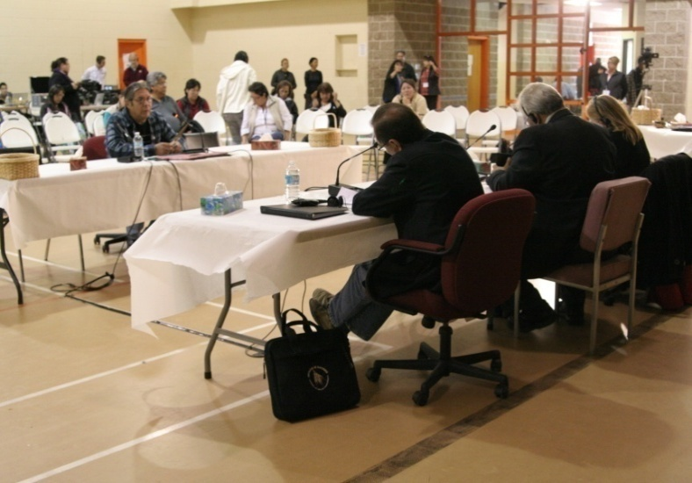
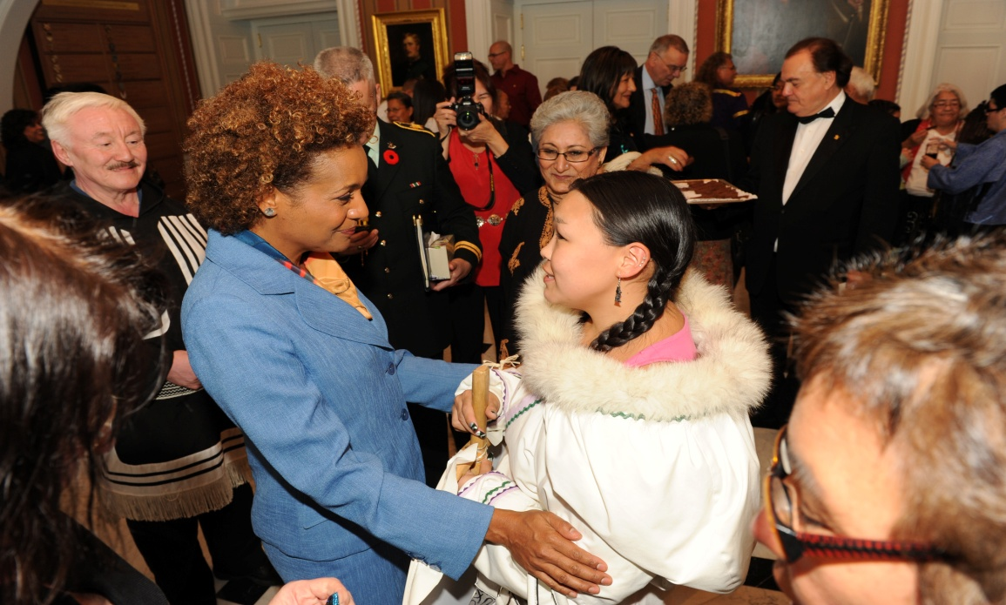
Commission begins public work
2007: Indian Residential Schools Settlement Agreement creates historic Commission.
2009: Three new Commissioners named
Governor General Michaëlle Jean inducted: First “TRC Honorary Witness”
Witnessing the Future’ launch event, Rideau Hall, October 2009

Slide 29
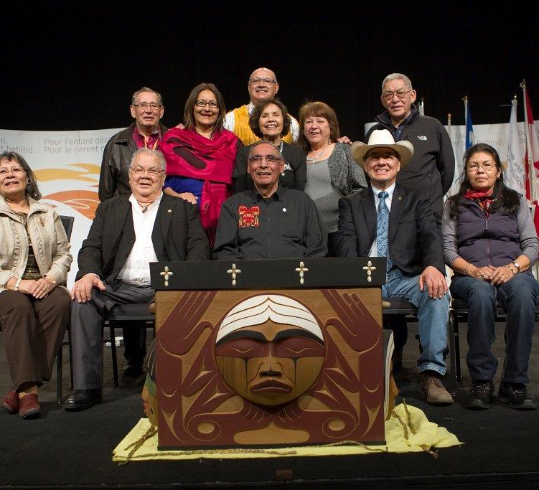
Survivors as TRC “owners” & Advisors
TRC Survivors Committee:
Eugene Arcand, Madeleine Basile, John Banksland, Terri Brown, John Morrisseau, Lottie May Johnson, Barney Williams Jr., Gordon Williams, Rebekah Uqi Williams, Doris Young
Inuit Sub-commission:
Jennifer Hunt-Poitras & Robbie Watt

Slide 30
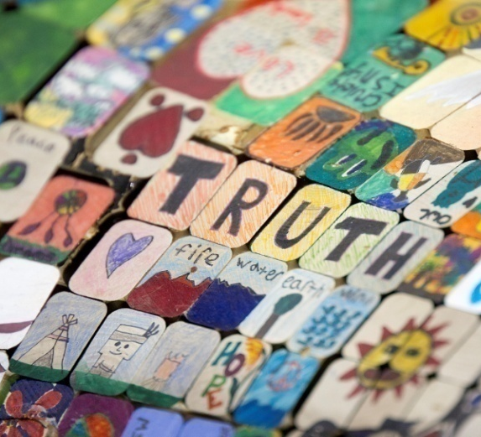
Statement Gathering
TRC Hearings
77 communities
7 National Events
240 hearing days
7,000 statements
2/3 were public
1/3 private: 65% of private gave permission to use for public education purposes

Slide 31
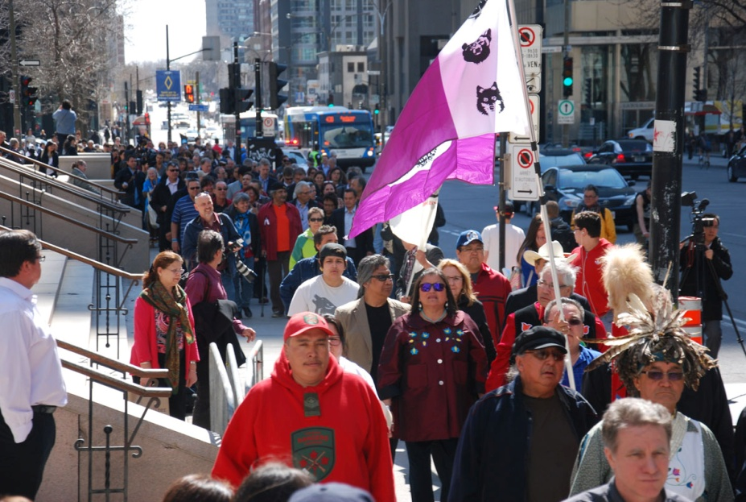
Public Response
ATTENDANCE:
National Events: 55,500 (EST)
Regional Events:
Victoria: 5,000
Whitehorse: 1,000
Education Days: 14,300 Students
Online: 68 Countries >250,000 views
National Events:
RESPECT: Winnipeg, June 2010
COURAGE: Inuvik, June-July 2011
LOVE: Halifax, October, 2011
TRUTH: Saskatoon, June, 2012
HUMILITY: Montreal, April, 2013
HONESTY: Vancouver, Sept. 2013
WISDOM: Edmonton, March, 2014

Slide 32
TRC Honorary Witnesses
“Reconciliation” is a beautiful word . . . It connotes images of aspiration, of expectation, and hope for a positive outcome. It is all about creating something new while fully recognizing the past. . .
Both parties need to address the situation in truth, understand its profound impact, learn lessons, and then rebuild….
Honourable David C. Onley, TRC Honorary Witness
Notes:
The TRC inducted Honorary Witnesses following the time-honoured Aboriginal tradition of asking people to bear witness to important ceremonies and events in the life of their communities.
Her Excellency Madame Michaëlle Jean, a former Governor General of Canada, was the first person appointed as a TRC Honorary Witness.
The 54 individuals inducted as Honorary Witnesses over the course of the TRC’s mandate come from all walks of life and include people who have worked on justice issues and reconciliation in contexts outside of Canada as well as many accomplished and respected Canadians.

Slide 33
2012
Publication:
They Came for the Children
TRC Interim Report
2012–2014
Commemoration:
$20 million Fund
143 Projects:
2014
Documentation:
National Centre for Truth &
Reconciliation (NCTR)
2015
Validation & Conclusion:
The Survivors Speak
What We Have Learned: Principles of Reconciliation
TRC Calls to Action
Documenting & Remembering

Slide 34
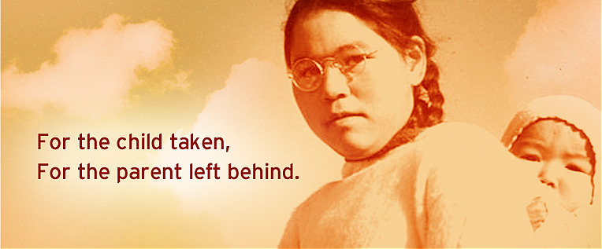
TRC Final Report & Calls to Action
History of Schools
The Missing Children
School Legacy issues:
Education
Culture and Language
Spirituality
Health
Justice
Governance
Poverty
The Missing & Murdered
Child Welfare
Reconciliation

Slide 35
TRC Key Findings
PRINCIPLES OF RECONCILIATION:
UN Declaration on Rights of Indigenous Peoples is framework for reconciliation.
First Nations, Inuit & Métis peoples have Treaty, constitutional and Treaty rights that must be recognized & respected.
Reconciliation is process of healing relationships that requires public truth sharing, apology, commemoration & redress of past harms.

Slide 36
TRC Key Findings
PRINCIPLES OF RECONCILIATION:
Reconciliation requires action to address destructive impacts on Aboriginal education, language & culture, health, child welfare, administration of justice, economic opportunity & prosperity.
Reconciliation must create more equitable society, closing gaps in social, health & economic outcomes.
All Canadians are Treaty peoples & share responsibility for mutually respectful relationships.

Slide 37
TRC Key Findings
PRINCIPLES OF RECONCILIATION:
Perspectives of Aboriginal Elders & Knowledge Keepers re concepts & practices of reconciliation are vital to long-term reconciliation.
Aboriginal cultural revitalization, & integration of Indigenous knowledge systems, oral histories, laws, protocols & connection to land are essential to reconciliation process.
Reconciliation requires political will, joint leadership, trust building, accountability, transparency, & investment of resources.
Reconciliation requires sustained public education, dialogue, & youth engagement about history & legacy of residential schools, Treaties & aboriginal rights, & past and present contributions of Indigenous peoples to Canadian society.

Slide 38
Mandate Letter from Prime Minister Trudeau to Ministers
“No relationship is more important to me and to Canada than the one with Indigenous Peoples. It is time for a renewed, nation-to-nation relationship with Indigenous Peoples, based on recognition of rights, respect, co-operation and partnership”.

Slide 39
Mandate Letter from Prime Minister Trudeau to Minister of Indigenous and Northern Affairs.
“I expect you to re-engage in a renewed nation-to-nation process with Indigenous Peoples to make real progress on the issues most important to First Nations, the Metis Nation, and Inuit communities – issues like housing, employment, health and mental health care, community safety and policing, child welfare, and education.”…
To support the work of reconciliation, and continue the necessary process of truth telling and healing, work with provinces and territories, and with First Nations, the Metis Nation, and Inuit, to implement recommendations of the Truth and Reconciliation Commission, starting with the implementation of the United Nations Declaration on the Rights of Indigenous Peoples…”
Prime Minister Justin Trudeau

Slide 40
General Comment No. 11
Paragraph 29:
In the design of special measures, States should consider the needs of indigenous children who may face multiple facets of discrimination and also take into account the differences in rural and urban situations. Particular attention should be given to girls and indigenous children with disabilities.

Slide 41
Expert Mechanism Report (EMRIP)
Expert Mechanism Advice No. 1 (2009) on the rights of Indigenous Peoples to Education
Expert Mechanism Advice No. 2 (2011): Indigenous peoples and the right to participate in decision-making
Expert Mechanism Follow-up report on Indigenous Peoples and the right to participate in decision-making, with a focus on extractive industries (2012)
Expert Mechanism Advice No. 5 (2013): Access to justice in the promotion and protection of the rights of Indigenous Peoples
Expert Mechanism Advice No. 6 (2014): Restorative justice, Indigenous juridical systems and access to justice for Indigenous women, children and youth, and persons with disabilities

Slide 42
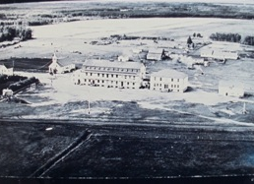
Ermineskin, Alberta, Canada

Slide 43
Ermineskin, Alberta, Canada

Slide 44
